Slide 1

Python
Dr. Panem Charanarur

Slide 2
Overview
History
Installing & Running Python

Slide 3
Brief History of Python
Invented in the Netherlands, early 90s by Guido van Rossum
Named after Monty Python
Open sourced from the beginning
Considered a scripting language, but is much more
Scalable, object oriented and functional from the beginning
Used by Google from the beginning
Increasingly popular

Slide 4

Python’s Benevolent Dictator For Life
“Python is an experiment in how much freedom program-mers need. Too much freedom and nobody can read another's code; too little and expressive-ness is endangered.”
- Guido van Rossum

Slide 5
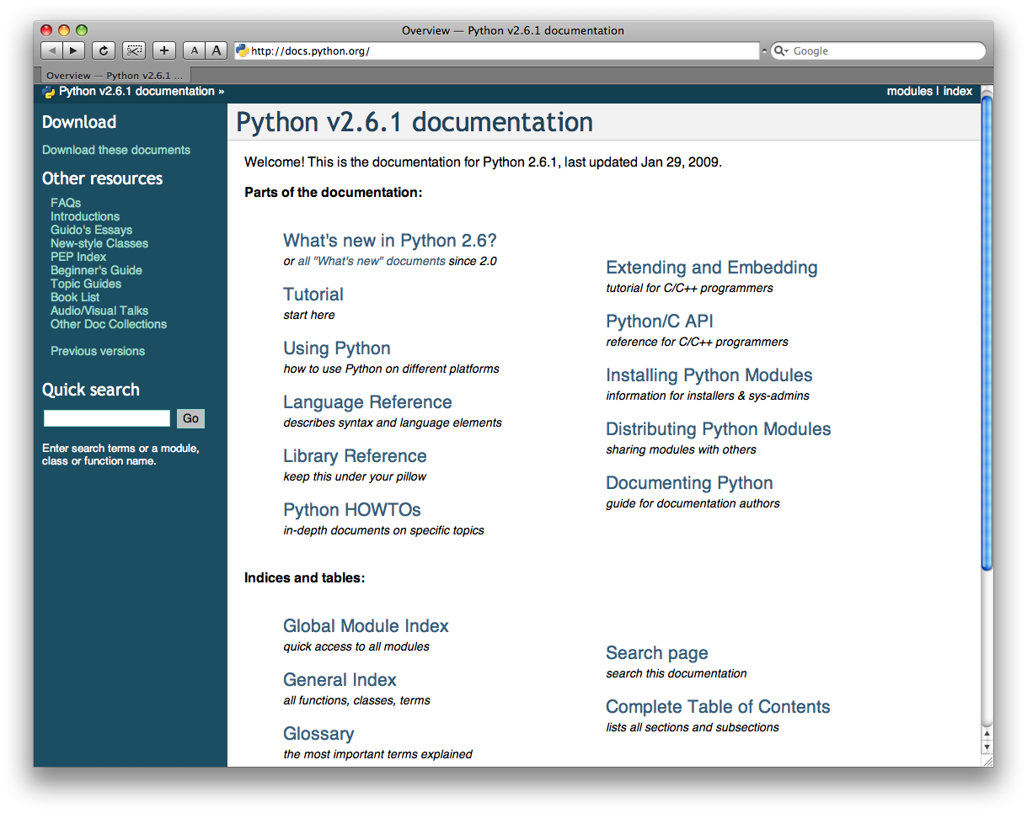
http://docs.python.org/

Slide 6
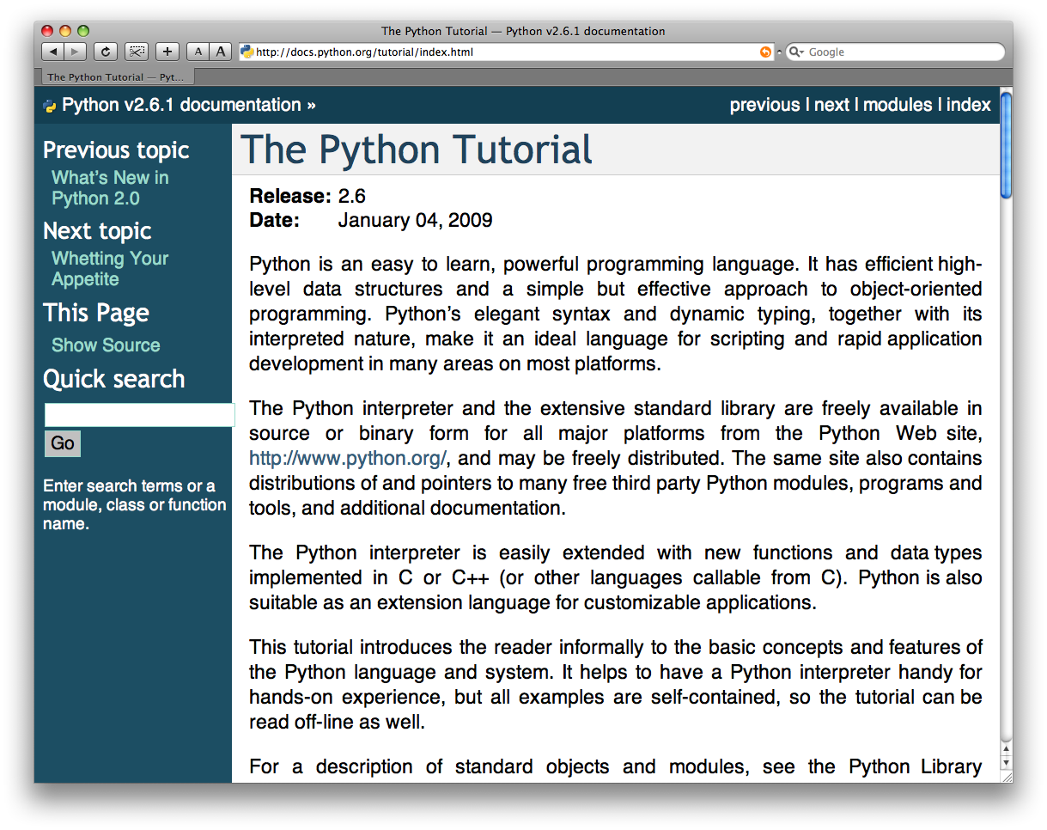
The Python tutorial is good!

Slide 7
Warmup
Windows:
Open anaconda prompt
Type conda –V
If you get an error, install Anaconda: https://docs.anaconda.com/anaconda/install/windows/
  #8 is important: DO NOT add to your path
If no error, consider upgrading conda:
conda update conda
Clone https://github.com/Harvard-IACS/2019-CS109B
(or pull the latest if you’ve already cloned)
Mac:
Open a terminal
Type conda –V
If you get an error, install Anaconda:
https://docs.anaconda.com/anaconda/install/mac-os/
If no error, consider upgrading conda:
  conda update conda
Clone https://github.com/Harvard-IACS/2019-CS109B
(or pull the latest if you’ve already cloned)

Slide 8

Goals
Set up the tools you’ll need for CS109b
  In a way that won’t mess up your other classes
Teach a workflow that will keep your installs tidy
User-level understanding of why ‘environments’ are helpful
Stretch: Ability to produce conda environments for future projects

Slide 9
Basic Python Commands
1. Comments: # symbol is being used for comments in python. For multiline comments, you have to use “”” symbols or enclosing the comment in the “”” symbol.
Example:
print “Hello World” # this is the comment section.
Example:
“”” This is Hello world project.”””
2. Type function: These Python Commands are used to check the type of variable and used inbuilt functions to check.
Example:
type (20), its type is int.
>>> type (20) < type ‘int’ >
Example:
type (-1 +j), its type is complex
>>> type (-1+j)
< type ‘complex’ >
3. Strings: It is mainly enclosed in double-quotes.
Example:
type (“hello World”), type is string
>>> type (“hello World”)
< type ‘str’ >

Slide 10
4. Lists: Lists are mainly enclosed in square bracket. [ ]
Example:
type ( [ 1, 2 ] ), type is list
>>> type ( [ 1, 2, 3 ] )
< type ‘List’ >
5.Tuple: Tuple are mainly enclosed in parenthesis. ( )
Example:
type ( 1, 2, 3), a type is a tuple.
>>> type ( ( 1, 2, 3) )
<type ‘tuple’ >
6. Range: This function is used to create the list of integers. Range(10)
Example:
>>> range ( 10 )
Output: [0, 1, 2, 3, 4, 5, 6, 7, 8, 9]
Example: range(1,10)
>>> range (1,10)
Output: [1, 2, 3, 4, 5, 6, 7, 8, 9]
7. Boolean values: This data type helps in retrieving the data in True or false form.
Example:
>>> True
True
>>> type (True)
< type ‘bool’ >
Example:
>>> False
False
>>> type (False)
< type ‘bool’ >

Slide 11
8. Operator: Different operator is used for the different functions like division, multiply, addition and subtraction.
Example:
>>> 16/2 16/2=8
8
Example:
>>> 2 * * ½ 2 **, -, +
1
9. Variable and assignment: The assignment statement has variable = expression. Single ‘=’ is used for assignment, and double ‘= =’ is used to test for quality.
Example:
>>> X= 235
>>> print X
235
>>> Z= 2* X
>>> print Z
470
10. Comparison operators: To compare the two values and the result of the comparison is always boolean value.
Example:
>>> 2 < 3
True

Slide 12
11. Conditional/ decisions: It is used to make out the decision between two or more values like if-else
Example:
if x=0:
Print “Hello, world.”
Else:
Print “Hello, world in Else.”
12. For Loop: This Python command is used when iteration and action consist of the same elements.
Example:
for x in [ 1, 2, 3, 4, 5, 6]:
Print x;
13. While loop: While loop will never be executed if the condition evaluates to false for the first time.
Example:
x =0
while x<10:
Print x,
X= x+2
14. Else in loop: Loop have optional else for execution.
Example:
for x in [ 1, 3, 5, 7, 9, 11]:
Print x
Else:
Print “In Else”

Slide 13
15. Break, continue statement: break statement is used to exit out the loop when particular output is achieved; continue is used to continue with the next iteration of a loop.
Example:
if x==0:
Print “X is 0”
Break
Else:
Print “X is greater than 0.”
16. Lists: It is the finite number of items, and by assigning a value to list the list value will get changed.
Example:
>>> a = [1, “JAY”, 34] >>> a [0] 1
>>> a [0] = 101
>>> a
[101, “JAY”, 34]
17. Length of list: To know the length if list.
Example:
>>> X = [1, 4, 67,9] >>> len (X)
4
18. Sublists: It will give you the values between the mentioned start index and the end index.
Example:
x [start : end] >>> X [1, 3, 4,6, 7, 8, 9, 0, 2] >>> X [2:5] [4, 6, 7]
19. Joining two list: + operator is being used to concatenate 2 lists.
Example:
>>> [2, 1, 5] + [0, 4,6,7] [2, 1, 5, 0, 4, 6,7]

Slide 14
20. Strings: It is used to check the index to know the character written in string.
Example:
>>> x= “hello, world” “”
>>> x [2] ‘l’
>>> x [5] ‘o’
21. List methods: The different methods available to in list to perform the function.
Example:
X [1, 2,3,4,5]
>>> X.append (7)
>>> x
[1, 2, 3, 4, 5, 7]
>>>X.insert (0, 0)
>>> x
[0, 1, 2, 3, 4, 5]
>>> X.remove (2)
>>> x
[0, 1, 3, 4, 5]
>>> X.pop (1)
>>> x
[2,3,4,5]

Slide 15
Python Conditions and If statements:
Python supports the usual logical conditions from mathematics:
Equals: a == b
Not Equals: a != b
Less than: a < b
Less than or equal to: a <= b
Greater than: a > b
Greater than or equal to: a >= b
These conditions can be used in several ways, most commonly in "if statements" and loops.
An "if statement" is written by using the if keyword.

Slide 16
Example If statement:
a = 33
b = 200
if b > a:
print("b is greater than a")
Elif: The elif keyword is pythons way of saying "if the previous conditions were not true, then try this condition".
Example
a = 33
b = 33
if b > a:
print("b is greater than a")
elif a == b:
print("a and b are equal")

Slide 17
Else:The else keyword catches anything which isn't caught by the preceding conditions.
Example
a = 200
b = 33
if b > a:
print("b is greater than a")
elif a == b:
print("a and b are equal")
else:
print("a is greater than b")
And:The and keyword is a logical operator, and is used to combine conditional statements
Example:Test if a is greater than b, AND if c is greater than a:
a = 200
b = 33
c = 500
if a > b and c > a:
print("Both conditions are True")

Slide 18
Python For Loops:A for loop is used for iterating over a sequence (that is either a list, a tuple, a dictionary, a set, or a string).
This is less like the for keyword in other programming languages, and works more like an iterator method as found in other object-orientated programming languages.
Example
Print each fruit in a fruit list:
fruits = ["apple", "banana", "cherry"]
for x in fruits:
print(x)
The break Statement:With the break statement we can stop the loop before it has looped through all the items:
Example
Exit the loop when x is "banana":
fruits = ["apple", "banana", "cherry"]
for x in fruits:
print(x)
if x == "banana":
break

Slide 19
The continue Statement:With the continue statement we can stop the current iteration of the loop, and continue with the next
Example
Do not print banana:
fruits = ["apple", "banana", "cherry"]
for x in fruits:
if x == "banana":
continue
print(x)
The range() Function:To loop through a set of code a specified number of times, we can use the range() function,
The range() function returns a sequence of numbers, starting from 0 by default, and increments by 1 (by default), and ends at a specified number.
Example
Using the range() function:
for x in range(6):
print(x)

Slide 20
Python Lists:Lists are used to store multiple items in a single variable.
Lists are one of 4 built-in data types in Python used to store collections of data, the other 3 are Tuple, Set, and Dictionary, all with different qualities and usage.
Lists are created using square brackets:
Example
Create a List:
thislist = ["apple", "banana", "cherry"]
print(thislist)
List Length:To determine how many items a list has, use the len() function:
Example
Print the number of items in the list:
thislist = ["apple", "banana", "cherry"]
print(len(thislist))
List Items - Data Types:List items can be of any data type:
Example:String, int and boolean data types:
list1 = ["apple", "banana", "cherry"]
list2 = [1, 5, 7, 9, 3]
list3 = [True, False, False]

Slide 21
Dictionary: Dictionaries are used to store data values in key:value pairs.
A dictionary is a collection which is ordered*, changeable and do not allow duplicates.
Dictionaries are written with curly brackets, and have keys and values
Example
Create and print a dictionary:
thisdict = {
"brand": "Ford",
"model": "Mustang",
"year": 1964
}
print(thisdict)
Dictionary Length:To determine how many items a dictionary has, use the len() function:
Example
print(len(thisdict))
Dictionary Items - Data Types
ExampleString, int, boolean, and list data types:
thisdict = {
"brand": "Ford",
"electric": False,
"year": 1964,
"colors": ["red", "white", "blue"]
}

Slide 22
Network: The standard library of Python has full support for network protocols, encoding, and decoding of data and other networking concepts, and it is simpler to write network programs in Python
There are two levels of network service access in Python. These are:
Low-Level Access
High-Level Access
In the first case, programmers can use and access the basic socket support for the operating system using Python's libraries, and programmers can implement both connection-less and connection-oriented protocols for programming.
Sockets use protocols for determining the connection type for port-to-port communication between client and server machines. The protocols are used for:
Domain Name Servers (DNS)
IP addressing
E-mail
FTP (File Transfer Protocol) etc.

Slide 23
Python has a socket method that let programmers' set-up different types of socket virtually. The syntax for the socket method is:
Syntax:
g = socket.socket (socket_family, type_of_socket, protocol=value)
For example, if we want to establish a TCP socket, we can write the following code snippet:
Example:
# imports everything from 'socket'
from socket import *
# use socket.socket() - function
tcp1=socket.socket(socket.AF_INET, socket.SOCK_STREAM)
you defined the socket, you can use several methods to manage the connections. Some
of the important server socket methods are:
listen(): is used to establish and start TCP listener.
bind(): is used to bind-address (host-name, port number) to the socket.
accept(): is used to TCP client connection until the connection arrives.
connect(): is used to initiate TCP server connection.
send(): is used to send TCP messages.
recv(): is used to receive TCP messages.
sendto(): is used to send UDP messages
close(): is used to close a socket.

Slide 24
Selection:
Python’s select() function is a direct interface to the underlying operating system implementation.
It monitors sockets, open files, and pipes (anything with a fileno() method that returns a valid file descriptor) until they become readable or writable, or a communication error occurs. select() makes it easier to monitor multiple connections at the same time, and is more efficient than writing a polling loop in Python using socket timeouts, because the monitoring happens in the operating system network layer, instead of the interpreter.
Note:Using Python’s file objects with select() works for Unix, but is not supported under Windows.
Example:
import select
import socket
import sys
import Queue
# Create a TCP/IP socket
server = socket.socket(socket.AF_INET, socket.SOCK_STREAM)
server.setblocking(0)
# Bind the socket to the port
server_address = ('localhost', 10000)
print >>sys.stderr, 'starting up on %s port %s' %
server_address server.bind(server_address)
# Listen for incoming connections
server.listen(5)

Slide 25
Functions: In Python, a defined function's declaration begins with the keyword def and followed by the function name.
The function may take arguments(s) as input within the opening and closing parentheses, just after the function name followed by a colon.
After defining the function name and arguments(s) a block of program statement(s) start at the next line and these statement(s) must be indented.
Here is the syntax of a user defined function.
Syntax:
def function_name(argument1, argument2, ...) :
statement_1 statement_2 ....
Example:
def nsquare(x, y):
return (x*x + 2*x*y + y*y)
print("The square of the sum of 2 and 3 is : ", nsquare(2, 3))

Slide 26
Python Iterators:An iterator is an object that contains a countable number of values.
An iterator is an object that can be iterated upon, meaning that you can traverse through all the values.
Technically, in Python, an iterator is an object which implements the iterator protocol, which consist of the methods __iter__() and __next__()
Example: Create an iterator that returns numbers, starting with 1, and each sequence will increase by one (returning 1,2,3,4,5 etc.):
class MyNumbers:
def __iter__(self):
self.a = 1
return self
def __next__(self):
x = self.a
self.a += 1
return x
myclass = MyNumbers()
myiter = iter(myclass)
print(next(myiter))
print(next(myiter))
print(next(myiter))
print(next(myiter))
print(next(myiter))
Example:Stop after 20 iterations:
class MyNumbers:
def __iter__(self):
self.a = 1
return self
def __next__(self):
if self.a <= 20:
x = self.a
self.a += 1
return x
else:
raise StopIteration
myclass = MyNumbers()
myiter = iter(myclass)
for x in myiter:
print(x)

Slide 27
Python Classes:
To create a class, use the keyword class.
Example1:Create a class named MyClass, with a property named x:
class MyClass:
x = 5
Example 2:Create a class named Person, use the __init__() function to assign values for name and age:
class Person:
def __init__(self, name, age):
self.name = name
self.age = age
p1 = Person("John", 36)
print(p1.name)
print(p1.age)
Python Objects:
Example1:Create an object named p1, and print the value of x:
p1 = MyClass()
print(p1.x)
Example 2:Insert a function that prints a greeting, and execute it on the p1 object:
class Person:
def __init__(self, name, age):
self.name = name
self.age = age
def myfunc(self):
print("Hello my name is " + self.name)
p1 = Person("John", 36)
p1.myfunc()

Slide 28
Python Inheritance
Inheritance allows us to define a class that inherits all the methods and properties from another class.
Parent class is the class being inherited from, also called base class.
Child class is the class that inherits from another class, also called derived class.
Create a Parent Class
Any class can be a parent class, so the syntax is the same as creating any other class:
Example
Create a class named Person, with firstname and lastname properties, and a printname method:
class Person:
def __init__(self, fname, lname):
self.firstname = fname
self.lastname = lname
def printname(self):
print(self.firstname, self.lastname)
#Use the Person class to create an object, and then execute the printname method:
x = Person("John", "Doe")
x.printname()
Composition (Has-A Relation)
Here, by using the class name or by creating the object we can access the members of one class inside another class. It enables creating complex types by combining objects of different classes. It means that a class Composite can contain an object of another class Component. This type of relationship is known as Has-A Relation.
Example:
class Component:
# composite class constructor
def __init__(self):
print('Component class object created...')
# composite class instance method
def m1(self):
print('Component class m1() method executed...')
class Composite:
# composite class constructor
def __init__(self):
# creating object of component class
self.obj1 = Component()
print('Composite class object also created...')
# composite class instance method
def m2(self):
print('Composite class m2() method executed...')
# calling m1() method of component class
self.obj1.m1()
# creating object of composite class
obj2 = Composite()
# calling m2() method of composite class
obj2.m2()

Slide 29
Python Comments
Comments can be used to explain Python code.
Comments can be used to make the code more readable.
Comments can be used to prevent execution when testing code.
Creating a Comment
Comments starts with a #, and Python will ignore them:
Example
#This is a comment
print("Hello, World!")
Python Numbers
There are three numeric types in Python:
int
float
complex
Variables of numeric types are created when you assign a value to them:
Example
x = 1 # int
y = 2.8 # float
z = 1j # complex
print(type(x))
print(type(y))
print(type(z))

Slide 30
Python Math
Python has a set of built-in math functions, including an extensive math module, that allows you to perform mathematical tasks on numbers.
Built-in Math Functions
The min() and max() functions can be used to find the lowest or highest value in an iterable:
Example
x = min(5, 10, 25)
y = max(5, 10, 25)
print(x)
print(y)
Variable Names
A variable can have a short name (like x and y) or a more descriptive name (age, carname, total_volume).
Rules for Python variables:
A variable name must start with a letter or the underscore character.
A variable name cannot start with a number.
A variable name can only contain alpha-numeric characters and underscores (A-z, 0-9, and _ ).
Variable names are case-sensitive (age, Age and AGE are three different variables)
Example
#Legal variable names:
myvar = "John"
my_var = "John"
_my_var = "John"
myVar = "John"
MYVAR = "John"
myvar2 = "John"
#Illegal variable names:
2myvar = "John"
my-var = "John"
my var = "John"

Slide 31
Introduction of Anaconda:
Anaconda is a data science platform for data scientists, IT professionals, and business leaders. It is a distribution of Python, R, etc. With more than 300 packages for data science, it quickly became one of the best platforms for any project
https://docs.anaconda.com/anaconda/install/windows/

Slide 32
File Handling
Python also support file handling like other languages which include different file operations like opening a file, reading, writing and closing the file but before going into depth first we need to understand why we do file handling what is the need of file handling.
File Operations
Opening a File
python has inbuild function to open a file. This function returns a file object, also called handle. we call it handle as it is used to read or modify a file accordingly.
f=open('file_name.txt')
Read and Write (perform operations)
Python File Mode
'r' open file for read (default)
'w' write , it create a new file if it does not exist or truncate the file if it exists.‘
x' open a file for exclusive creation but if file already exists then the operation will fail.
'a' open for appending at the end of file without truncating it and if no file exist already then it create a new one.
't' open file in text mode(default)'b' open file in binary mode. we can use binary mode for storing matrix or list of data.
'+' open a file for updating (reading and writing)

Slide 33
Close file
closing a file is done by mostly using close() method. python has a garbage collector to clean up an referenced object but, we must not rely on it to close the file.
f=open('file_name.txt')
f.close()

Slide 34
Python - sys Module
The sys module provides functions and variables used to manipulate different parts of the Python runtime environment. You will learn some of the important features of this module here.
sys.argv
sys.argv returns a list of command line arguments passed to a Python script. The item at index 0 in this list is always the name of the script. The rest of the arguments are stored at the subsequent indices.
import sys
print("You entered: ",sys.argv[1], sys.argv[2], sys.argv[3])
sys.exit
This causes the script to exit back to either the Python console or the command prompt. This is generally used to safely exit from the program in case of generation of an exception.
sys.maxsize
Returns the largest integer a variable can take.
import sys
sys.maxsize
sys.path
This is an environment variable that is a search path for all Python modules.
import sys
sys.path
sys.version
This attribute displays a string containing the version number of the current Python interpreter.
import sys
sys.version

Slide 35
Python - OS Module
It is possible to automatically perform many operating system tasks. The OS module in Python provides functions for creating and removing a directory (folder), fetching its contents, changing and identifying the current directory, etc.
You first need to import the os module to interact with the underlying operating system. So, import it using the import os statement before using its functions.
Getting Current Working Directory
The getcwd() function confirms returns the current working directory.
Example: Get Current Working Directory
import os
os.getcwd()

Slide 36
Creating a Directory
We can create a new directory using the os.mkdir() function, as shown below.
Example: Create a Physical Directory
import os
os.mkdir("C:\MyPythonProject")
Changing the Current Working Directory
We must first change the current working directory to a newly created one before doing any operations in it. This is done using the chdir() function. The following change current working directory to C:\MyPythonProject.
Example: Change Working Directory
import os
os.chdir("C:\MyPythonProject") # changing current working directory
os.getcwd()

Slide 37
Removing a Directory
The rmdir() function in the OS module removes the specified directory either with an absolute or relative path. Note that, for a directory to be removed, it should be empty.
Example: Remove Directory
import os
os.rmdir("C:\\MyPythonProject")
List Files
The listdir() function returns the list of all files and directories in the specified directory.
Example: List Directories
import os
os.listdir("c:\python37")

Slide 38
Geolocation Acquisition in Python?
we will discuss on how to get Geolocation when you enter any location name and its gives all the useful information such as postal code, city, state, country etc. with the latitudes and the longitudes (the specific coordinates) and vice-versa in which we provide the coordinates to get the location name.
This can be done using the GeoPy library in python. This library isn’t built into python and hence needs to be installed explicitly.
Method 1: Getting coordinates from location name
With provided location, it is possible using geopy to extract the coordinates meaning its latitude and longitude. Therefore, it can be used to express the location in terms of coordinates.
Approach
Import module
Import Nominatim from geopy- Nominatim is a free service or tool or can be called an API with no keys that provide you with the data after providing it with name and address and vice versa.
On calling the Nomination tool which accepts an argument of user_agent you can give any name as it considers it to be the name of the app to which it is providing its services.
The geocode() function accepts the location name and returns a geodataframe that has all the details and since it’s a dataframe we can get the address, latitude and longitude by simply calling it with the given syntax
Syntax:
variablename.address
variablename.latitude
variablename.longitude.

Slide 39
# importing geopy library
from geopy.geocoders import Nominatim
# calling the Nominatim tool
loc = Nominatim(user_agent="GetLoc")
# entering the location name
getLoc = loc.geocode("Gosainganj Lucknow")
# printing address
print(getLoc.address)
# printing latitude and longitude
print("Latitude = ", getLoc.latitude, "\n")
print("Longitude = ", getLoc.longitude)

Slide 40
Method 2: Getting location name from latitude and longitude
In this method all the things are same as the above, the only difference is instead of using the geocode function we will now use the reverse() method which accepts the coordinates (latitude and longitude) as the argument, this method gives the address after providing it with the coordinates.
Syntax:
reverse(latitude,longitude)
Approach
Import module
Call nominatim tool
Pass latitude and longitude to reverse()
Print location name

Slide 41
# importing modules
from geopy.geocoders import Nominatim
# calling the nominatim tool
geoLoc = Nominatim(user_agent="GetLoc")
# passing the coordinates
locname = geoLoc.reverse("26.7674446, 81.109758")
# printing the address/location name
print(locname.address)

Slide 42
What Are Whitelists and Blacklists?
As an example of how whitelists and blacklists work, let’s consider a system administrator working for Google. Google is the most popular website globally — nearly everyone on the internet uses Google — but with its popularity comes nefarious users who may try to attack it, bring down its servers, or compromise user data. A system administrator will need to blacklist IP addresses acting nefariously while allowing all other valid incoming traffic.
Now, let’s suppose that this same system administrator needs to configure a development server for Google’s own internal use and testing. This system admin will need to block all incoming IP addresses except for the whitelisted IP addresses of Google’s developers.
The concept of whitelisting and blacklisting characters for OCR purposes is the same. A whitelist specifies a list of characters that the OCR engine is only allowed to recognize — if a character is not on the whitelist, it cannot be included in the output OCR results.
The opposite of a whitelist is a blacklist. A blacklist specifies the characters that, under no circumstances, can be included in the output.

Slide 43
Packet Analysis:
With Python code, you can iterate over the packets in a pcap, extract relevant data, and process that data in ways that make sense to you.
You can use code to go over the pcap and locate a specific sequence of packets (i.e. locate the needle in the haystack) for later analysis in a GUI tool like Wireshark.
Or you can create customized graphical plots that can help you visualize the packet information. Further, since this is all code, you can do this repeatedly with multiple pcaps
Note: https://vnetman.github.io/pcap/python/pyshark/scapy/libpcap/2018/10/25/analyzing-packet-captures-with-python-part-1.html

Slide 44
Packet Reassembly:
Network protocols often need to transport large chunks of data which are complete in themselves, e.g. when transferring a file. The underlying protocol might not be able to handle that chunk size (e.g. limitation of the network packet size), or is stream-based like TCP, which doesn’t know data chunks at all.
In that case the network protocol has to handle the chunk boundaries itself and (if required) spread the data over multiple packets. It obviously also needs a mechanism to determine the chunk boundaries on the receiving side.
Wireshark calls this mechanism reassembly, although a specific protocol specification might use a different term for this (e.g. desegmentation, defragmentation, etc).

Slide 45
Payload Extraction:

Slide 46
Forensic Python
Extracting valuable information from the resources available is a vital part of digital forensics.
Getting access to all the information available is essential for an investigation process as it helps in retrieving appropriate evidence.
Resources that contain data can be either simple data structures such as databases or complex data structures such as a JPEG image.
Simple data structures can be easily accessed using simple desktop tools, while extracting information from complex data structures require sophisticated programming tools.

Slide 47
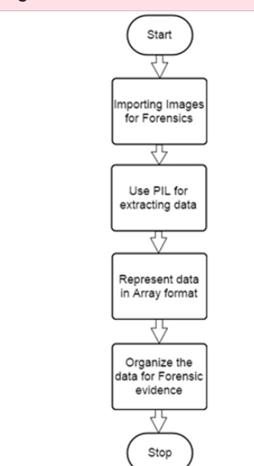
Python Imaging Library
The Python Imaging Library (PIL) adds image processing capabilities to your Python interpreter. This library supports many file formats, and provides powerful image processing and graphics capabilities.
Pillow is a fork of the Python Imaging Library (PIL). PIL is a library that offers several standard procedures for manipulating images. It's a powerful library but hasn't been updated since 2009 and doesn't support Python 3.
Pillow builds on this, adding more features and support for Python 3. It supports a range of image file formats such as PNG, JPEG, PPM, GIF, TIFF, and BMP. We'll see how to perform various operations on images such as cropping, resizing, adding text to images, rotating, greyscaling, etc., using this library.

Slide 48
Example
Now, let’s have a programming example to understand how it actually works.
Step 1 − Suppose we have the following image from where we need to extract information
Step 2 − When we open this image using PIL, it will first note the necessary points required for extracting evidence, which includes various pixel values. Here is the code to open the image and record its pixel values
Step 3 − Our code will produce the following output, after extracting the pixel values of the image.
The output delivered represents the pixel values of RGB combination, which gives a better picture of what data is needed for evidence. The data fetched is represented in the form of an array.

Slide 49
The Image Object
from PIL import Image
image = Image.open('demo_image.jpg')
image.show()
print(im.format)
print(im.mode)
print(im.size)
im.save('new_image.png')
new_image = im.resize((400, 400))
new_image.save('image_400.jpg')
print(im.size)
print(new_image.size)

Slide 50
Python MySQL
Python can be used in database applications.
One of the most popular databases is MySQL.
Why Python with SQL?
For Data Analysts and Data Scientists, Python has many advantages. A huge range of open-source libraries make it an incredibly useful tool for any Data Analyst
Create Connection
Start by creating a connection to the database.
Use the username and password from your MySQL database:
import mysql.connector
mydb = mysql.connector.connect(
host="localhost",
user="yourusername",
password="yourpassword"
)
print(mydb)

Slide 51
Creating a Database
To create a database in MySQL, use the "CREATE DATABASE" statement:
Example
create a database named "mydatabase":
import mysql.connector
mydb = mysql.connector.connect(
host="localhost",
user="yourusername",
password="yourpassword"
)
mycursor = mydb.cursor()
mycursor.execute("CREATE DATABASE mydatabase")

Slide 52
Insert Into Table
To fill a table in MySQL, use the "INSERT INTO" statement.
Example
Insert a record in the "customers" table:
import mysql.connector
mydb = mysql.connector.connect(
host="localhost",
user="yourusername",
password="yourpassword",
database="mydatabase"
)
mycursor = mydb.cursor()
sql = "INSERT INTO customers (name, address) VALUES (%s, %s)"
val = ("John", "Highway 21")
mycursor.execute(sql, val)
mydb.commit()
print(mycursor.rowcount, "record inserted.")
Insert Into Table
To fill a table in MySQL, use the "INSERT INTO" statement.
Example
Insert a record in the "customers" table:
import mysql.connector
mydb = mysql.connector.connect(
host="localhost",
user="yourusername",
password="yourpassword",
database="mydatabase"
)
mycursor = mydb.cursor()
sql = "INSERT INTO customers (name, address) VALUES (%s, %s)"
val = ("John", "Highway 21")
mycursor.execute(sql, val)
mydb.commit()
print(mycursor.rowcount, "record inserted.")

Slide 53
Select With a Filter
When selecting records from a table, you can filter the selection by using the "WHERE" statement:
Example
Select record(s) where the address is "Park Lane 38": result:
import mysql.connector
mydb = mysql.connector.connect(
host="localhost",
user="yourusername",
password="yourpassword",
database="mydatabase"
)
mycursor = mydb.cursor()
sql = "SELECT * FROM customers WHERE address ='Park Lane 38'"
mycursor.execute(sql)
myresult = mycursor.fetchall()
for x in myresult:
print(x)
Delete Record
You can delete records from an existing table by using the "DELETE FROM" statement:
Example
Delete any record where the address is "Mountain 21":
import mysql.connector
mydb = mysql.connector.connect(
host="localhost",
user="yourusername",
password="yourpassword",
database="mydatabase"
)
mycursor = mydb.cursor()
sql = "DELETE FROM customers WHERE address = 'Mountain 21'"
mycursor.execute(sql)
mydb.commit()
print(mycursor.rowcount, "record(s) deleted")

Slide 54
HTTP Communications with Python Built in Libraries
The http or Hyper Text Transfer Protocol works on client server model. Usually the web browser is the client and the computer hosting the website is the server. IN python we use the requests module for creating the http requests.
It is a very powerful module which can handle many aspects of http communication beyond the simple request and response data. It can handle authentication, compression/decompression, chunked requests etc.
# This function are return the json response of url and json data you send the server
def postReq(url, data):
# handle the exceptions
try:
# make a post request with
# the json data
res = requests.post(url, json=data)
# return the response after
# formatting in json.
return json.dumps(res.json(), indent=4)
except Exception as er:
return f"Message : {er}"
# Driver Code
if __name__ == '__main__':
# always run loop to make
# menu driven program
while True:
# handle the exceptions
try:
choice = int(input("1.Get Request\n2.Post Request\n3.Exit\nEnter Choice : "))
# get user choice and perform tasks.
if choice == 1:
# take a url as a input.
url_inp = input("Enter a valid get url : ")
# print the result of the url.
print(getReq(url_inp))
elif choice == 2:
# take a url as a input
url_inp = input("Enter a valid get url : ")
# take a formal data as input in dictionary.
data_inp = {
"name": input("Name : "),
"email": input("Email : "),
"work": input("Work : "),
"age": input("Age : ")
}
# print the result.
print(postReq(url_inp, data_inp))
elif choice == 3:
# if user want to exit.
exit(0)
except Exception as e:
print("Error : ", e)
# api testing using pyton
# request module to work with api's
import requests
# json module to parse and get json
import json
# This function are return the
json response from given url
def getReq(url):
# handle the exceptions
try:
# make a get request using requests
# module and store the result.
res = requests.get(url)
# return the result after
# formatting in json.
return json.dumps(res.json(), indent=4)
except Exception as ee:
return f"Message : {ee}"

Slide 55
1. Grequests
GRequests allows you to use Requests with Gevent to make asynchronous HTTP Requests easily.
Command: pip install grequests
import grequests
urls = [
‘http://www.heroku.com’,
‘http://python-tablib.org’,
‘http://httpbin.org’,
‘http://python-requests.org’,
‘https://yeahhub.com/’
]

Slide 56
2. httplib2 – Comprehensive HTTP client library.
The Hypertext Transfer Protocol (HTTP) is an application protocol for distributed, collaborative, hypermedia information systems. HTTP is the foundation of data communication for the World Wide Web.
Python httplib2 module provides methods for accessing Web resources via HTTP. It supports many features, such as HTTP and HTTPS, authentication, caching, redirects, and compression. Httplib2 is a comprehensive HTTP client library, httplib2.py supports many features left out of other HTTP libraries.
HTTPS support is only available if the socket module was compiled with SSL support.
Command: pip install httplib2
#!/usr/bin/python3
import httplib2
http = httplib2.Http()
content = http.request(“https://www.yeahhub.com”)[1]
print(content.decode())

Slide 57
3. Requests – HTTP Requests for Humans.
Requests allows you to send organic, grass-fed HTTP/1.1 requests, without the need for manual labor. There’s no need to manually add query strings to your URLs, or to form-encode your POST data. Keep-alive and HTTP connection pooling are 100% automatic.
Command: pip install requests
#!/usr/bin/python3
import requests
#GET Request
r = requests.get(‘https://api.github.com/events’)
#POST Request
r = requests.post(‘http://httpbin.org/post’, data = {‘key’:’value’})

Slide 58
4. Treq – Python requests like API built on top of Twisted’s HTTP client
Treq is an HTTP library inspired by requests but written on top of Twisted’s Agents. It provides a simple, higher level API for making HTTP requests when using Twisted.
Command: pip install treq
#!/usr/bin/env python
from twisted.internet.task import react
from _utils import print_response
import treq
def main(reactor, *args):
d = treq.get(‘http://httpbin.org/get’)
d.addCallback(print_response)
return d
react(main, [])

Slide 59
5. Urllib3 – A HTTP library with thread-safe connection pooling, file post support, sanity friendly.
Urllib3 is a powerful, sanity-friendly HTTP client for Python. Much of the Python ecosystem already uses urllib3 and you should too. urllib3 brings many critical features that are missing from the Python standard libraries:
Thread safety.
Connection pooling.
Client-side SSL/TLS verification.
File uploads with multipart encoding.
Helpers for retrying requests and dealing with HTTP redirects.
Support for gzip and deflate encoding.
Proxy support for HTTP and SOCKS.
100% test coverage.
Command: pip install urllib3
# Yeahhub.com
from requests.packages import urllib3
http = urllib3.PoolManager()
r = http.request(‘GET’, ‘https://yeahhub.com’)
print “r.status: “, r.status
print “r.data”, r.data

Slide 60
Web Communications with the Requests Module
What is the Request?
When you want to interact with data via a API, this is called a request. A request is made up of the following components:
Endpoint – The URL that delineates what data you are interacting with. Similar to how a web page URL is tied to a specific page, an endpoint URL is tied to a specific resource within an API.
Method– Specifies how you’re interacting with the resource located at the provided endpoint. REST APIs can provide methods to enable full Create, Read, Update, and Delete (CRUD) functionality. Here are common methods most REST APIs provide:
GET – Retrieve data
PUT – Replace data
POST – Create data
DELETE – Delete data

Slide 61
Unit-I
Scripting Part-1

Slide 62
Shell Overview
What is a Shell?
UNIX shells provide a "command line" interface which allows the user to enter commands which are translated by the shell into something the kernel can comprehend and then is sent off to the kernel for it to act upon.
The user can pick their shell (just like the applications, desktop manger, window manager, etc. on a UNIX system).
UMBC Shells
On the UMBC GL network, the default UNIX shell is tcsh - Turbo C SHell. The default can be changed by the user via http://accounts.umbc.edu/.
Shells available on GL include:
  tcsh - Turbo C SHell
  csh - C SHell
  ksh - Korn SHell
  bash - Bourne Again SHell
  sh - SHell

Slide 63
Shell Overview
Linux Default Shell
  Most Linux systems (especially home installations) default to the bash shell.
Changing Your Shell - On a Home Based System
  Usually there is a command called chsh that stands for change shell. You have to enter your password and then the absolute path to the new shell that you wish to use.
(06:08 PM): chsh
Changing shell for Eric.
Password: New shell [/bin/bash]: /bin/csh
Shell changed.

Slide 64
Understanding the File System Tree and its Navigation
A file system is a logical collection of files on a partition or disk. A partition is a container for information and can span an entire hard drive if desired.
Your hard drive can have various partitions which usually contain only one file system, such as one file system housing the /file system or another containing the /home file system.
One file system per partition allows for the logical maintenance and management of differing file systems.
Everything in Unix is considered to be a file, including physical devices such as DVD-ROMs, USB devices, and floppy drives.

Slide 65
I/O Redirection
The work of any command is either taking input or gives an output or both. So, Linux has some command or special character to redirect these input and output functionalities. For example: suppose we want to run a command called “date” if we run it will print the output to the current terminal screen. But our requirement is different, we don’t want the output to be displayed on the terminal. We want the output to be saved in a file. This could be done very easily with output redirection. Redirection here simply means diverting the output or input.
Similarly, if we have a command that needs input to be performed. Let take a command “head” this needs input to give output. So either we write input in the form of command directly or redirect input from any other place or file. Suppose we have a file called “file.txt” to print the starting some lines of the file we could use the “head”. So let’s see how this all is done on the terminal.
Types of Redirection
1. Overwrite
“>” standard output
“<” standard input
2. Appends
“>>” standard output
“<<” standard input
3. Merge
“p >& q” Merges output from stream p with stream q
“p <& q” Merges input from stream p with stream q

Slide 66
cat > file.txt
cat < file.txt
cat
cat >> file.txt

Slide 67
Expansion
If you are using a Linux system, you might already know how crucial a shell interface is for interacting with your system. On most Linux distributions, Bash is the default shell that we use to run commands and execute scripts. A shell script is a set of commands that, when executed, is used to perform some useful function(s) on Linux. This .sh file, written by a user, contains all the commands used to perform a task so that we do not have to run those commands manually, one by one.
In this tutorial, we will explain two of the most useful bash expansions used in shell scripts:
$() – the command substitution: Command substitution allows the output of a command to replace the command itself
${} – the parameter substitution/variable expansion: A parameter, in Bash, is an entity that is used to store values. A parameter can be referenced by a number, a name, or by a special symbol.
An expansion in Shell is performed on the script after it has been split into tokens. A token is a sequence of characters considered a single unit by the shell. It can either be a word or an operator.
${parameter}
name="john doe"
echo “${name}”
echo "The name of the person is $name_"
echo "The name of the person is ${name}_"
#!/bin/sh
echo ***Status Report***
TODAY=$(date)
echo "Today is $TODAY"
USERS=$(who | wc -l)
echo "$USERS users are currently logged in"
UPTIME=$(date ; uptime)
echo "The uptime is $UPTIME"

Slide 68
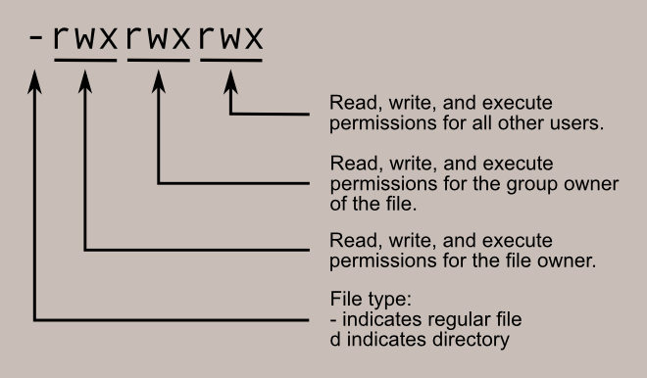
Permissions
The Unix-like operating systems, such as Linux differ from other computing systems in that they are not only multitasking but also multi-user.
What exactly does this mean? It means that more than one user can be operating the computer at the same time. While a desktop or laptop computer only has one keyboard and monitor, it can still be used by more than one user. For example, if the computer is attached to a network, or the Internet, remote users can log in via ssh (secure shell) and operate the computer. In fact, remote users can execute graphical applications and have the output displayed on a remote computer. The X Window system supports this.
This lesson will cover the following commands:
chmod - modify file access rights
su- temporarily become the superuser
sudo- temporarily become the superuser
chown- change file ownership
chgrp- change a file's group ownership
To check the file permission, give the following command:
$ ll file_name
The following command will add the read/write and execute permissions to the file wherein, u is for user, g is for group, and o is for others:
$ chmod ugo+rwx file_name

Slide 69
Job Control
Job control refers to the ability to selectively stop (suspend) the execution of processes and continue (resume) their execution at a later point. A user typically employs this facility via an interactive interface supplied jointly by the operating system kernel’s terminal driver and Bash.
The shell associates a job with each pipeline. It keeps a table of currently executing jobs, which may be listed with the jobs command.
A process in Linux means any running program. For example, when we run ls, it’s run as a process. If we search for a filename, by using ls -l and piping the result to grep, we’re actually running two processes:
$ ls -l
We list jobs using the jobs command.
we can kill a job we don’t need by using the kill command

Slide 70
Configuration and Environment variable
The configure shell script attempts to guess correct values for various system-dependent variables used during compilation. It uses those values to create a Makefile in each directory of the package (the top directory, the builtins, doc, and support directories, each directory under lib, and several others).
What is an environment variable?
Environment variables or ENVs basically define the behavior of the environment. They can affect the processes ongoing or the programs that are executed in the environment.
Scope of an environment variable
Scope of any variable is the region from which it can be accessed or over which it is defined. An environment variable in Linux can have global or local scope.
Global
A globally scoped ENV that is defined in a terminal can be accessed from anywhere in that particular environment which exists in the terminal. That means it can be used in all kind of scripts, programs or processes running in the environment bound by that terminal.
Local
A locally scoped ENV that is defined in a terminal cannot be accessed by any program or process running in the terminal. It can only be accessed by the terminal( in which it was defined) itself.
How to access ENVs?
SYNTAX:
$NAME
$ echo $NAME
To set a global ENV
$ export NAME=Value or $ set NAME=Value
$ echo $NAME
To set a local ENV
SYNTAX:
$ NAME=Value

Slide 72
Unit-II
Scripting Part-II

Slide 73
Package Management
Why a package manager?
For those of you who have already used Linux, you will have seen how simple it is to install software on a Linux machine via the “apt-get” or “yum install” or “rpm –ivh” commands.
A package manager keeps track of what software is installed on your computer, and allows you to easily install new software or remove software that you previously installed.
This feature was not available on Microsoft platforms except using 3rd party tools such as Chocolatey that were not officially supported by Microsoft. Since WMF 5, Microsoft has filled the gap in Windows by integrating a package manager called “PackageManagement“.
“PackageManagement” is a unified package management component that allows you to perform software discovery, installation and inventory for any type of software package that it supports through its extensible provider interface.
But it goes beyond that, as there exists a PowerShell module to interact with packages and which will allow you to automate packages management not only locally, but also remotely! This is a real breakthrough in the management of Windows packages.

Slide 74
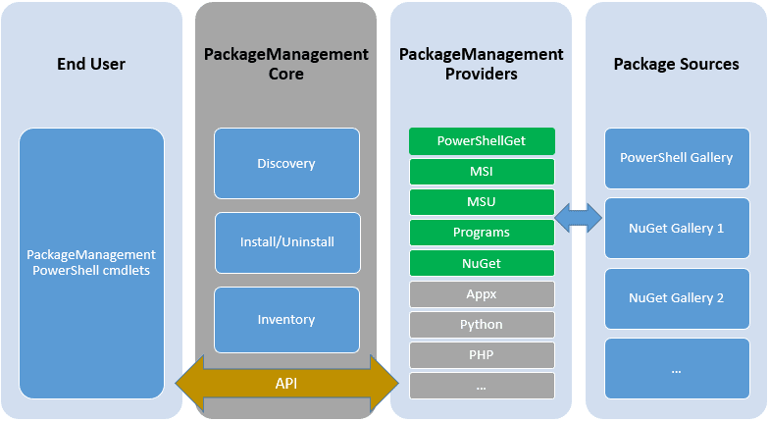
Architecture
To facilitate the understanding of this new concept, this article will be based on a diagram available on the TechNet website in order to analyse in detail the architecture of this new feature. “PackageManagement” is a Package Management Aggregator which is divided into four sections:

Slide 75
EndUser: As a user or sysadmin, you are in the “EndUser” section: This gives you access to several PowerShell cmdlets that we will use in the next section of this article.
PackageManagementCore: This corresponds to the actions that can be performed on your machine. Available actions are: discovery, install / uninstall and inventory.
PackageManagementProviders: This section regroups the providers that can interconnect to PackageManagementCore. It can be an officially-supported “Microsoft” provider or a 3rd party provider to expand the possibilities.
Package Sources: Also called “Repositories”. This is the place where the software packages are stored. These sources are managed by the providers themselves. Their location can be an online URL, a local folder or a network shared folder.

Slide 76
Storage Media:
When storing a command into a variable, we usually encounter problems like whitespace characters and complex command constructions.
We can use an array to store a single command and its parameters. We set the first element with the program’s name, and then each parameter in subsequent array positions:
$ COMMAND=("ls" "-l" "/var/log/httpd/access_log" "/var/log/file with spaces")Then, we can execute the command by expanding all the elements of the array:
$ "${COMMAND[@]}" -rw-r--r-- 1 root root 0 Jan 9 09:38 /var/log/file with spaces -rw-r--r-- 1 root root 0 Jan 8 17:21 /var/log/httpd/access_log

Slide 77
Networking
Linux networking commands are used extensively to inspect, analyze, maintain, and troubleshoot the network/s connected to the system.
Let us first know the list of the basic networking commands used in Linux followed by a detailed explanation of each.

Slide 78
Searching for Files:
The command in question is find. To make the understanding of this command even more enticing, once you know it, you can start working it into your Bash scripts. That’s not only convenience, that’s power.
How to use the find command
When I first glimpsed Linux, back in 1997, I didn’t quite understand how the find command worked; therefore, it never seemed to function as I expected. It seemed simple; issue the command find FILENAME (where FILENAME is the name of the file) and the command was supposed to locate the file and report back. Little did I know there was more to the command than that. Much more.
If you issue the command man find, you’ll see the syntax of the find command is:
find [-H] [-L] [-P] [-D debugopts] [-Olevel] [starting-point...] [expression]
find /path option filename
Remember, Linux is very particular about case, so if you’re looking for a file named Linux.odt, the following command will return no results.
find / -name linux.odt
f – regular file
d – directory
l – symbolic link
c – character devices
b – block devices

Slide 79
Archive and Backup:
One of the simplest ways to backup a system is using a shell script. For example, a script can be used to configure which directories to backup, and pass those directories as arguments to the tar utility, which creates an archive file. The archive file can then be moved or copied to another location. The archive can also be created on a remote file system such as an NFS mount.
The tar utility creates one archive file out of many files or directories. tar can also filter the files through compression utilities, thus reducing the size of the archive file.
Simple Shell Script
The following shell script uses tar to create an archive file on a remotely mounted NFS file system. The archive filename is determined using additional command line utilities.
#!/bin/bash #################################### # # Backup to NFS mount script. # #################################### #
What to backup.
backup_files="/home /var/spool/mail /etc /root /boot /opt"
# Where to backup to. dest="/mnt/backup" # Create archive filename. day=$(date +%A) hostname=$(hostname -s) archive_file="$hostname-$day.tgz" # Print start status message. echo "Backing up $backup_files to $dest/$archive_file" date echo
# Backup the files using tar. tar czf $dest/$archive_file $backup_files
# Print end status message. E
cho echo "Backup finished" date # Long listing of files in $dest to check file sizes.
ls -lh

Slide 80
$dest $backup_files: a variable listing which directories you would like to backup. The list should be customized to fit your needs.
$day: a variable holding the day of the week (Monday, Tuesday, Wednesday, etc). This is used to create an archive file for each day of the week, giving a backup history of seven days. There are other ways to accomplish this including using the date utility.
$hostname: variable containing the short hostname of the system. Using the hostname in the archive filename gives you the option of placing daily archive files from multiple systems in the same directory.
$archive_file: the full archive filename.
$dest: destination of the archive file. The directory needs to be created and in this case mounted before executing the backup script. See for details of using NFS.
status messages: optional messages printed to the console using the echo utility.
tar czf $dest/$archive_file $backup_files: the tar command used to create the archive file.
  c: creates an archive.
  z: filter the archive through the gzip utility compressing the archive.
  f: output to an archive file. Otherwise the tar output will be sent to STDOUT.
ls -lh $dest: optional statement prints a -l long listing in -h human readable format of the destination directory. This is useful for a quick file size check of the archive file. This check should not replace testing the archive file.

Slide 81
Regular Expressions are special characters which help search data and matching complex patterns. Regular expressions are shortened as ‘regexp’ or ‘regex’. They are used in many Linux programs like grep, bash, rename, sed, etc.
Basic Regular expressions
Some of the commonly used commands with Regular expressions are tr, sed, vi and grep. Listed below are some of the basic Regex.
Symbol | Descriptions
. | replaces any character
^ | matches start of string
$ | matches end of string
* | matches up zero or more times the preceding character
\ | Represent special characters
() | Groups regular expressions
? | Matches up exactly one character

Slide 82
Interval Regular expressions
These expressions tell us about the number of occurrences of a character in a string. They are
Expression | Description
{n} | Matches the preceding character appearing ‘n’ times exactly
{n,m} | Matches the preceding character appearing ‘n’ times but not more than m
{n, } | Matches the preceding character only when it appears ‘n’ times or more
Extended regular expressions
These regular expressions contain combinations of more than one expression. Some of them are:
Expression | Description
\+ | Matches one or more occurrence of the previous character
\? | Matches zero or one occurrence of the previous character

Slide 83
Formatting Output
Bash scripting is quite popular is the easiest scripting language. Like any programming or scripting language, you come across printing text on the terminal. This can happen in numerous scenarios such as when you want to output the contents of a file or check the value of a variable. Programmers also debug their applications by printing the values of their variables on the console. Therefore, before we delve into bash scripting which will be another tutorial, let’s look at the different ways in which we could output text in the terminal.
Echo is the most important command that you need to know in order to output text on the terminal. As the name itself suggests, echo displays number or string on standard output in the terminal. It also has a number of options available as shown in the table below.
Options | Definition
-n | Do not print the trailing newline
-E | Disable interpretation of back-slash escaped characters
-e | Enable interpretation of backslash escapes
\a | Alert
\b | Backspace
\c | Suppress trailing newline
\e | Escape
\f | Form feed
\\ | backslash
\n | New line
\r | Carriage return
\t | Horizontal tab
\v | Vertical tab

Slide 84
How to Write Shell Script in Linux/Unix
Shell Scripts are written using text editors. On your Linux system, open a text editor program, open a new file to begin typing a shell script or shell programming, then give the shell permission to execute your shell script and put your script at the location from where the shell can find it.
Let us understand the steps in creating a Shell Script:
Create a file using a vi editor(or any other editor). Name script file with extension .sh
Start the script with #! /bin/sh
Write some code.
Save the script file as filename.sh
For executing the script type bash filename.sh
“#!” is an operator called shebang which directs the script to the interpreter location. So, if we use”#! /bin/sh” the script gets directed to the bourne-shell.
Let’s create a small script –
#!/bin/sh
ls

Slide 85
Troubleshooting:
Troubleshooting shell scripts typically involves reviewing error messages printed by the shell program. Often a line number will be printed indicating the location of a syntax error. Otherwise, the fix requires interpreting how to respond to a printed error message. Troubleshooting tricks include the following, which are explained in sections below:
Redirect the output from the program to a file
Use the -x command parameter to run the shell script
Add echo commands to print information

Slide 86
Troubleshooting:
Troubleshooting shell scripts typically involves reviewing error messages printed by the shell program. Often a line number will be printed indicating the location of a syntax error. Otherwise, the fix requires interpreting how to respond to a printed error message. Troubleshooting tricks include the following, which are explained in sections below:
Redirect the output from the program to a file
Use the -x command parameter to run the shell script
Add echo commands to print information

